Slide 1
Network Fundamentals – Lecture 6
Network Layer
F. McLysaght Network Fundamentals

Slide 2
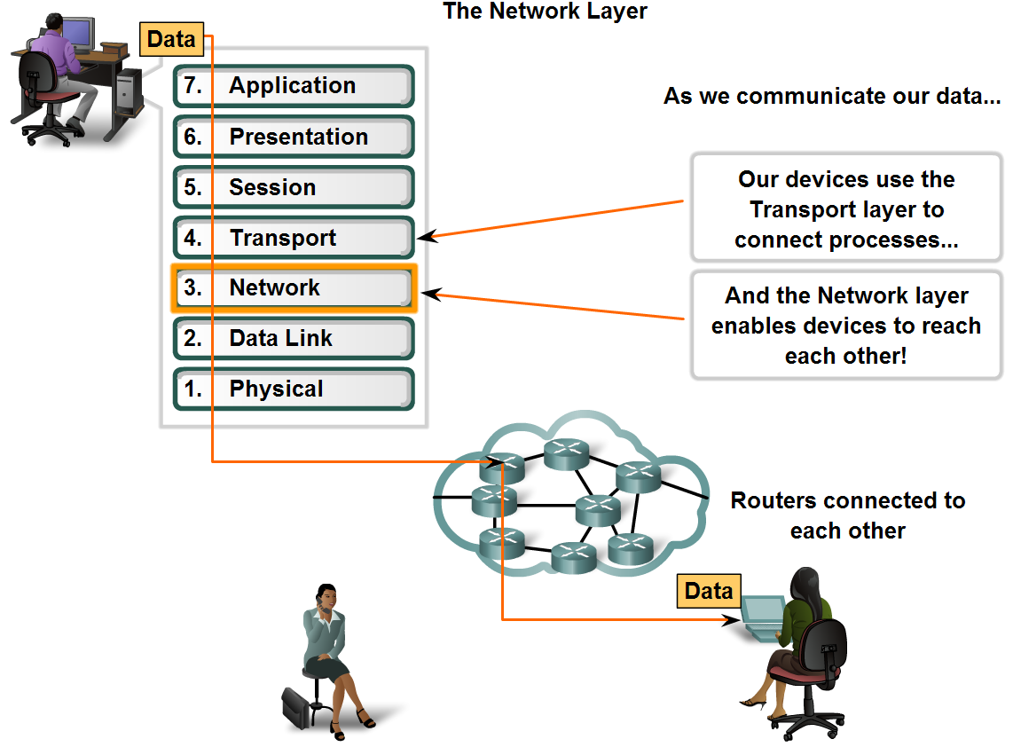
Network Layer Protocols and Internet Protocol (IP)
The basic role of the Network Layer in data networks is Best Path Determination.
F. McLysaght Network Fundamentals

Slide 3
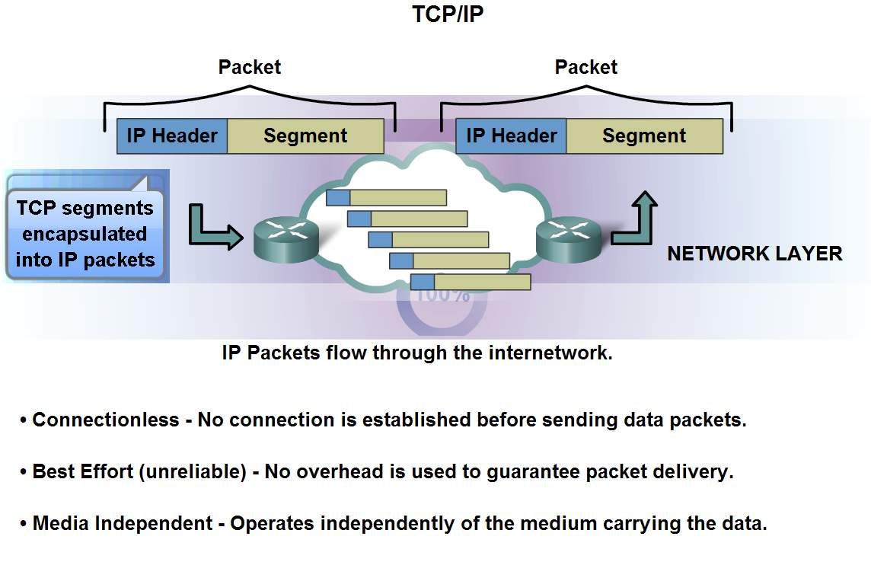
Network Layer Protocols and Internet Protocol (IP)
The Internet Protocol IPv4 (and now IPv6) operates at the network layer.
F. McLysaght Network Fundamentals

Slide 4
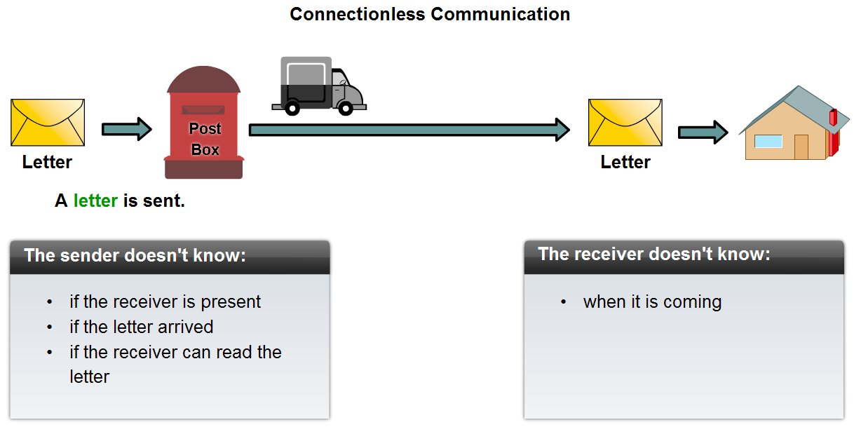
Network Layer Protocols and Internet Protocol (IP)
There are implications for the use of the IP protocol as it is connectionless
F. McLysaght Network Fundamentals

Slide 5
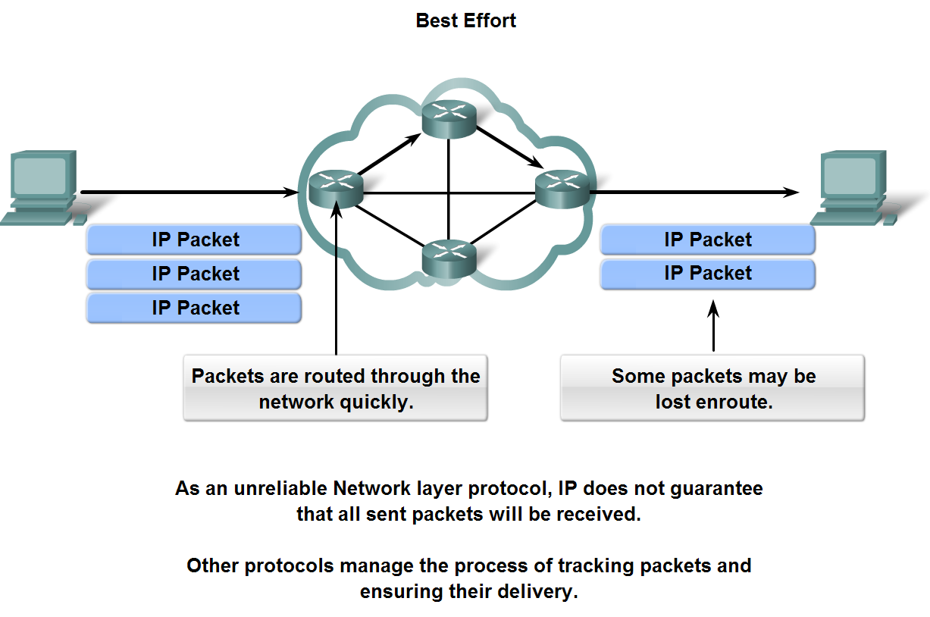
Network Layer Protocols and Internet Protocol (IP)
The IP protocol is considered an unreliable protocol
F. McLysaght Network Fundamentals

Slide 6
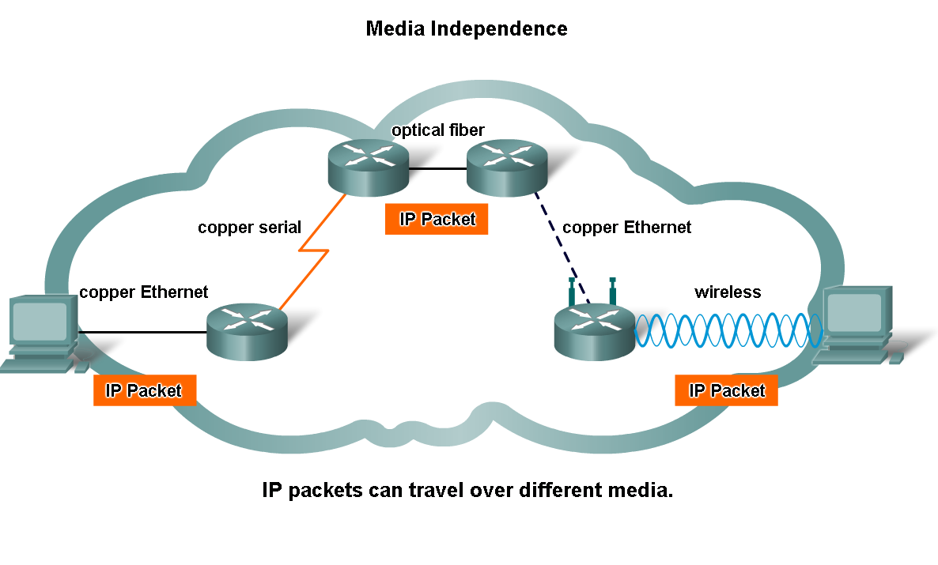
Network Layer Protocols and Internet Protocol (IP)
IP is media independent
F. McLysaght Network Fundamentals

Slide 7
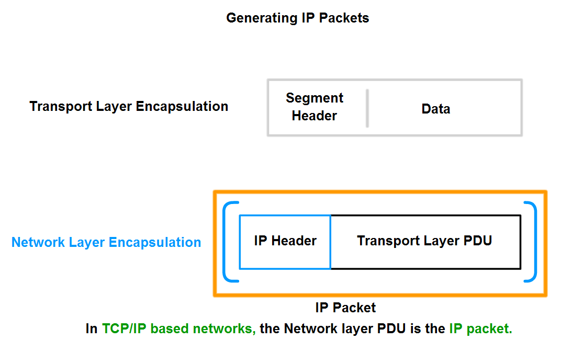
Network Layer Protocols and Internet Protocol (IP)
The Network layer encapsulates Transport Layer segments into layer 3 packets
F. McLysaght Network Fundamentals

Slide 8
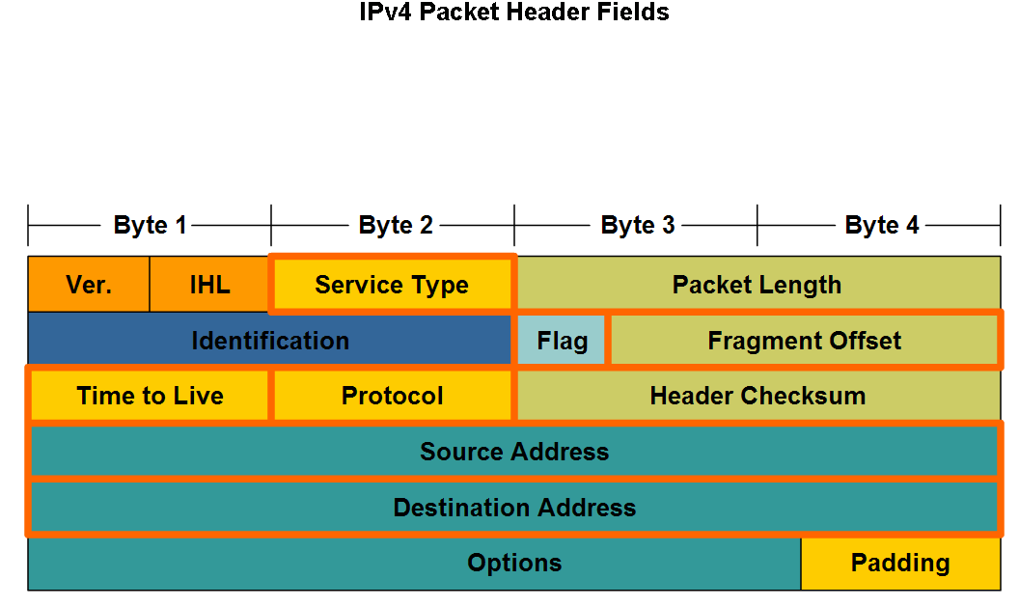
Network Layer Protocols and Internet Protocol (IP)
The major header fields in the IPv4 protocol are shown below.
F. McLysaght Network Fundamentals

Slide 9
Key IPv4 Header Fields
1] IP Destination Address
The IP Destination Address field contains a 32-bit binary value that represents the packet destination Network layer host address.
2] IP Source Address
The IP Source Address field contains a 32-bit binary value that represents the packet source Network layer host address.
3] Time-to-Live
The Time-to-Live (TTL) is an 8-bit binary value that indicates the remaining "life" of the packet. The TTL value is decreased by at least one each time the packet is processed by a router (that is, each hop). When the value becomes zero, the router discards or drops the packet and it is removed from the network data flow. This mechanism prevents packets that cannot reach their destination from being forwarded indefinitely between routers in a routing loop. If routing loops were permitted to continue, the network would become congested with data packets that will never reach their destination. Decrementing the TTL value at each hop ensures that it eventually becomes zero and that the packet with the expired TTL field will be dropped.
4] Protocol
This 8-bit binary value indicates the data payload type that the packet is carrying. The Protocol field enables the Network layer to pass the data to the appropriate upper-layer protocol.
Example values are: 01 ICMP 06 TCP 17 UDP
5] Type-of-Service
The Type-of-Service field contains an 8-bit binary value that is used to determine the priority of each packet. This value enables a Quality-of-Service (QoS) mechanism to be applied to high priority packets, such as those carrying telephony voice data. The router processing the packets can be configured to decide which packet it is to forward first based on the Type-of-Service value.
F. McLysaght Network Fundamentals

Slide 10
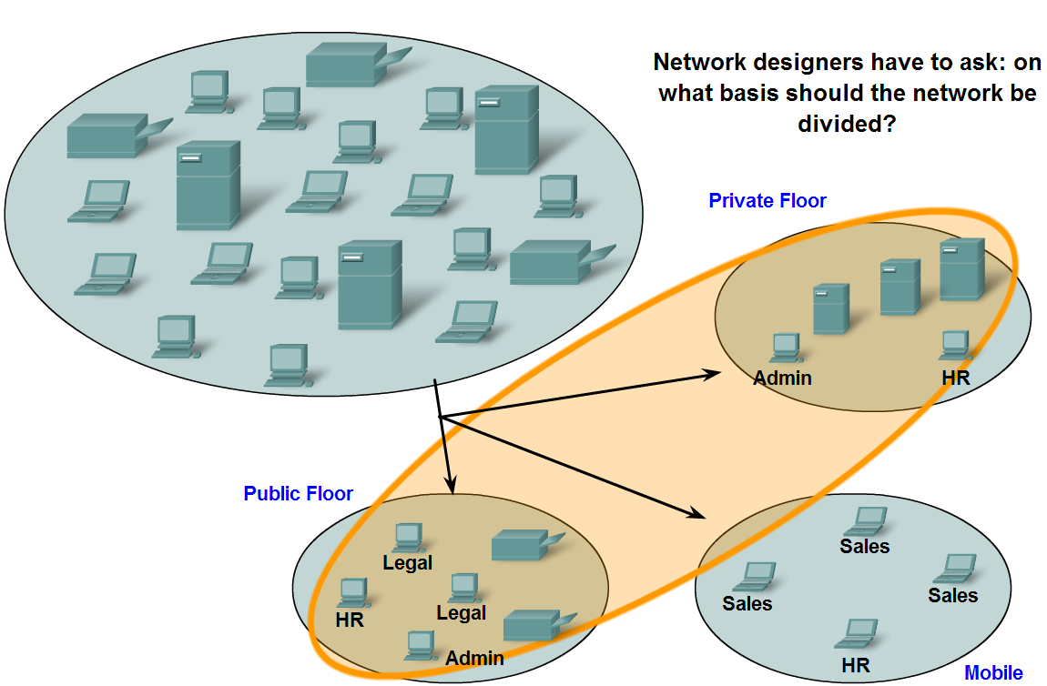
Rather than having all hosts everywhere connected to one vast global network, it is more practical and manageable to group hosts into specific networks.
F. McLysaght Network Fundamentals

Slide 11
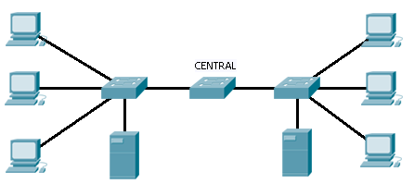
Layer 2 switches divides a network into many collision domains but just a single broadcast domain.
F. McLysaght Network Fundamentals

Slide 12
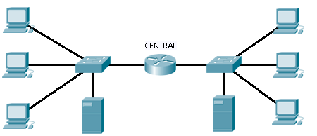
Replacing the central switch with a router results in two or more broadcast domains – this results in improved network performance.
F. McLysaght Network Fundamentals

Slide 13
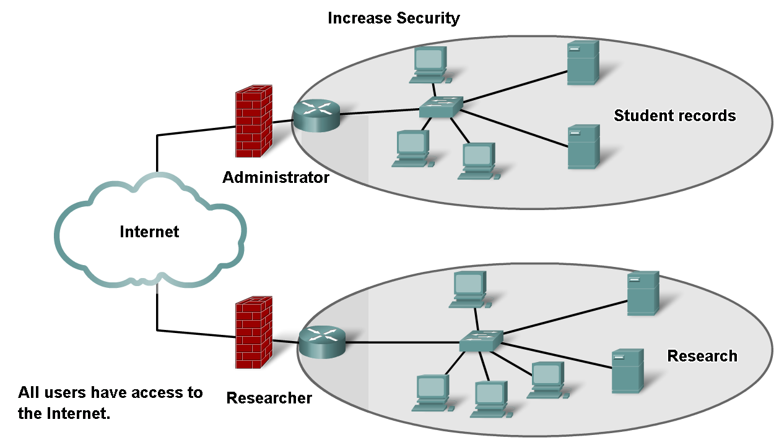
Dividing a large network can increase network security
Deny access
Deny access
F. McLysaght Network Fundamentals

Slide 14
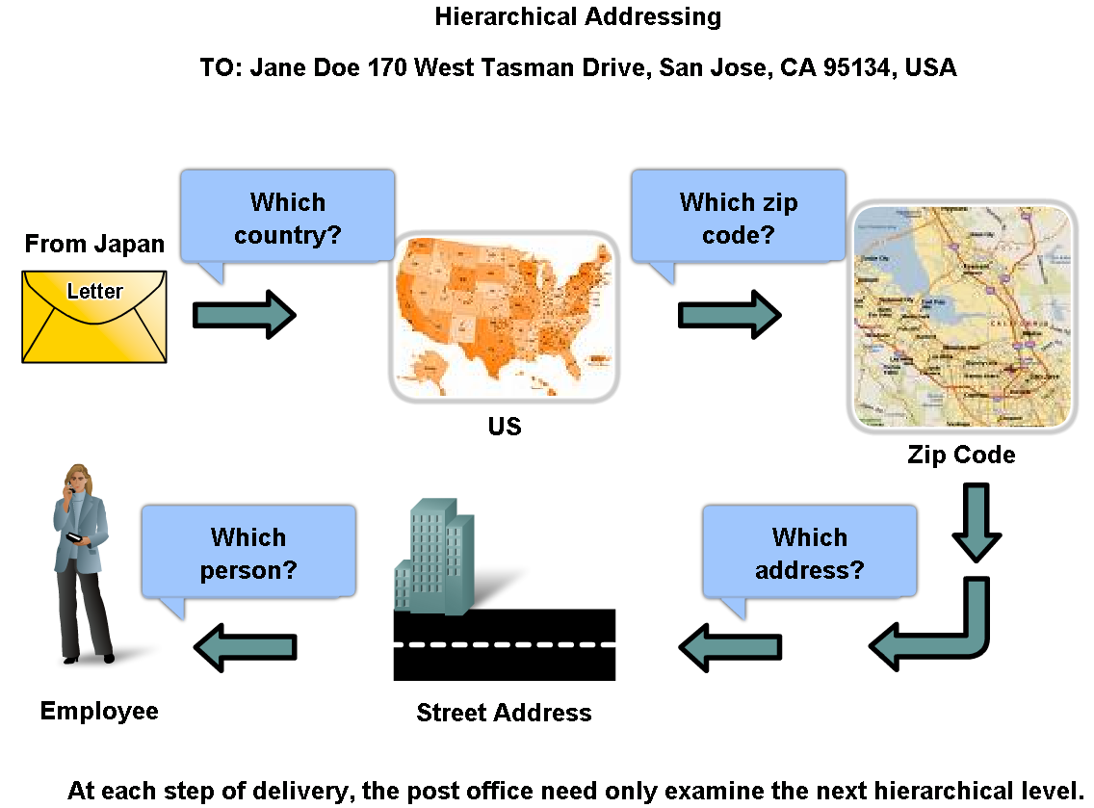
Hierarchical addressing solves the problem of devices communicating across networks of networks
F. McLysaght Network Fundamentals

Slide 15
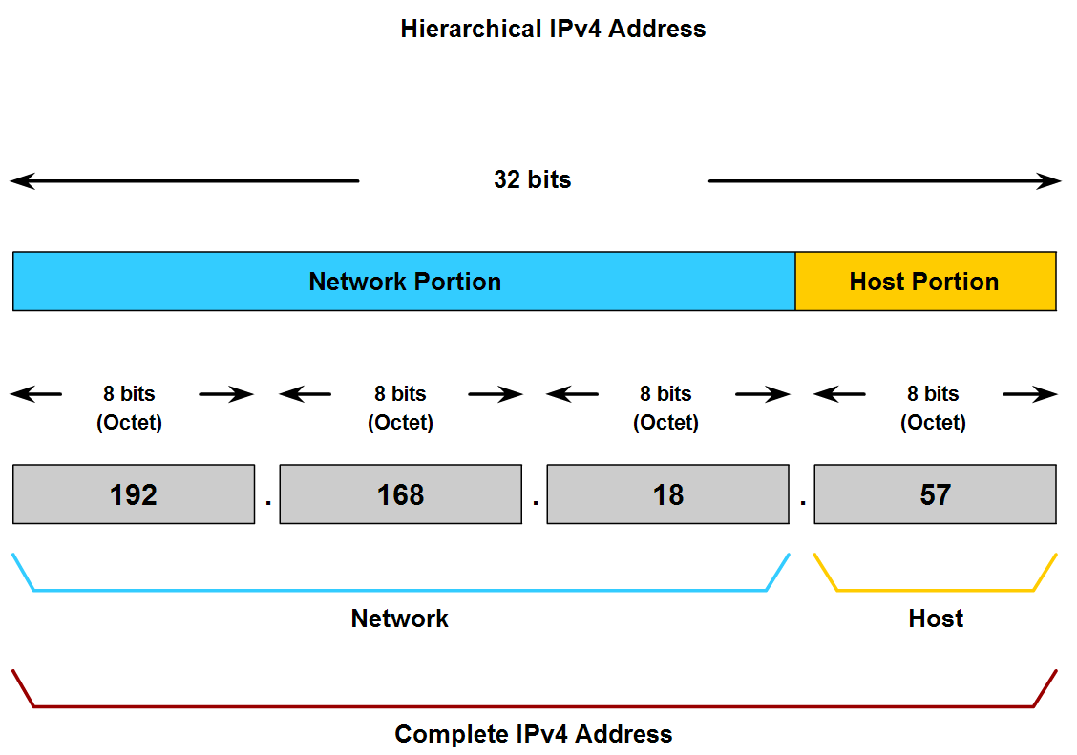
F. McLysaght Network Fundamentals

Slide 16
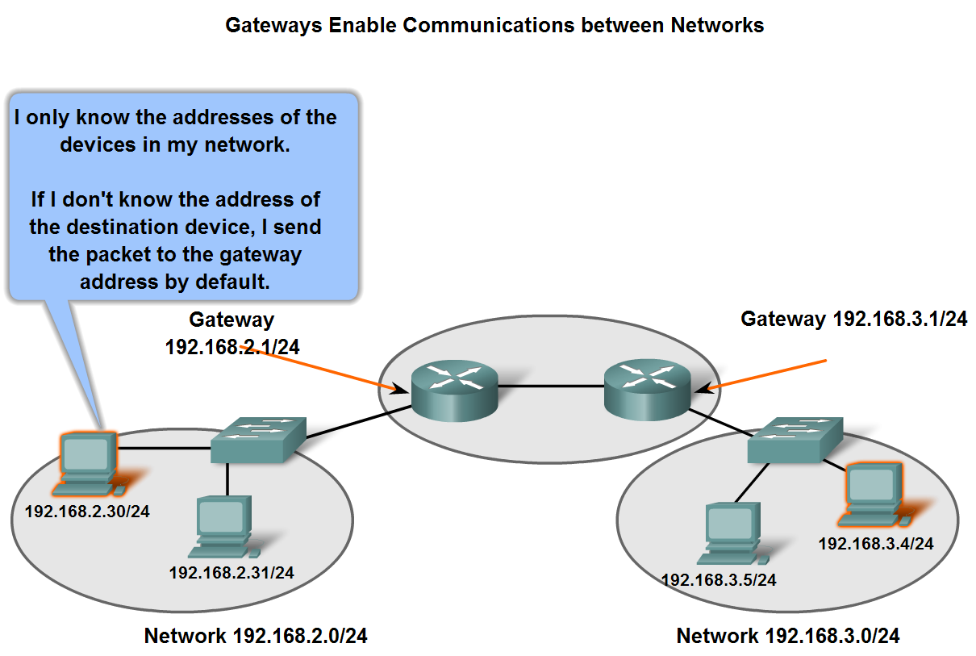
The role of an intermediary gateway device allows devices to communicate across sub-divided networks
F. McLysaght Network Fundamentals

Slide 17
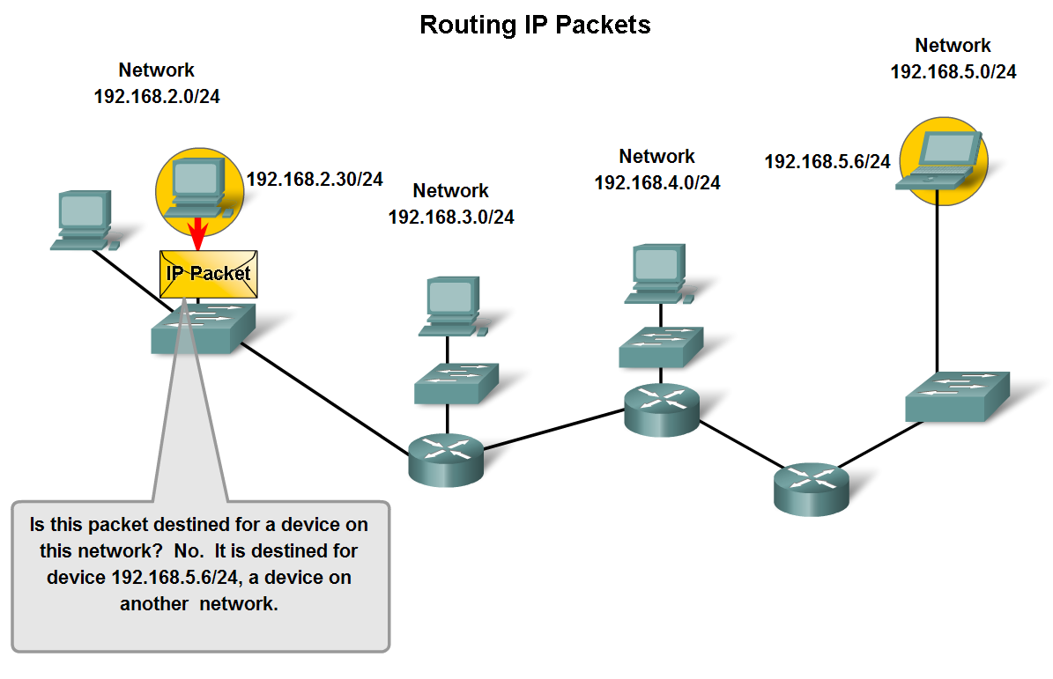
Trace the steps of an IP packet as it traverses unchanged via routers from sub network to sub-network
F. McLysaght Network Fundamentals

Slide 18
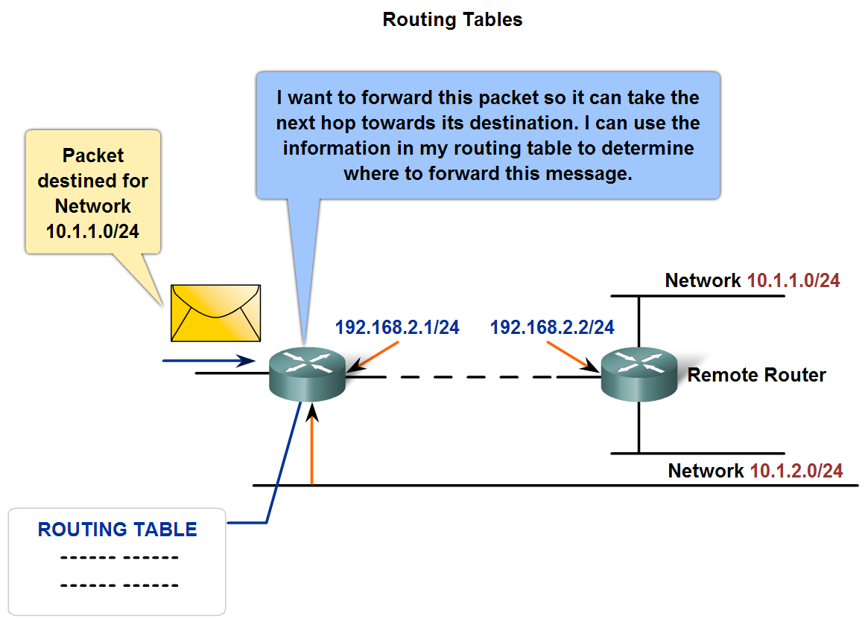
Routers use route tables to direct packets toward their ultimate destinations
F. McLysaght Network Fundamentals

Slide 19
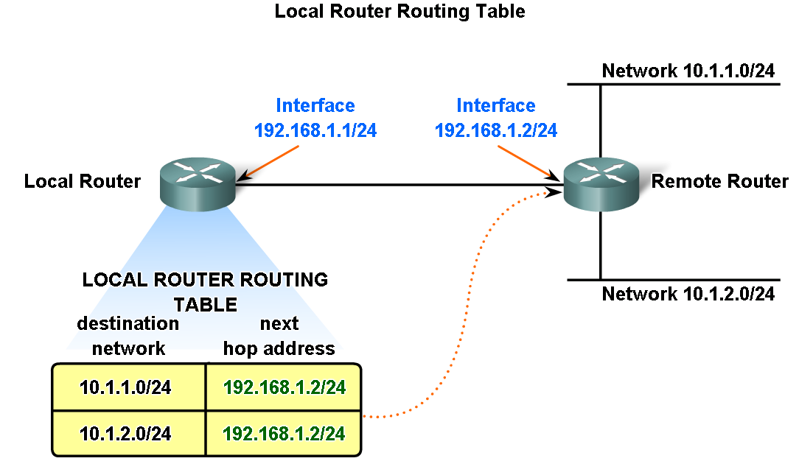
Routes in a routing table have three main features:
1] Destination network 2] Next-hop 3] Metric
F. McLysaght Network Fundamentals

Slide 20
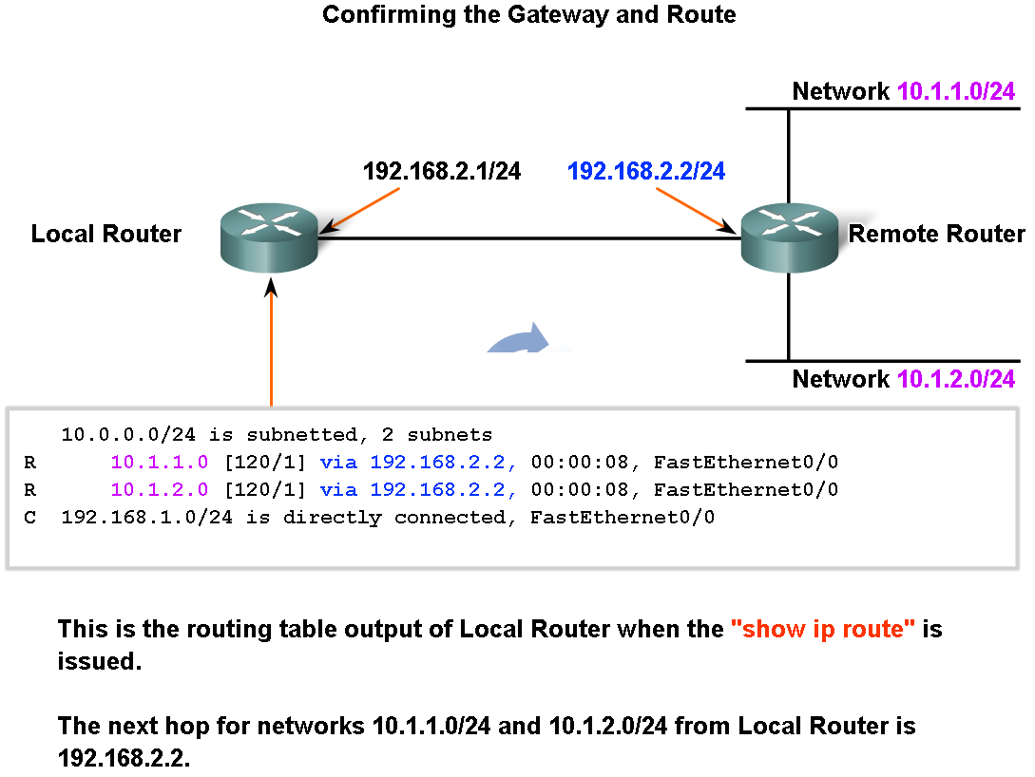
Describe the purpose and use of the destination network in a route
F. McLysaght Network Fundamentals

Slide 21
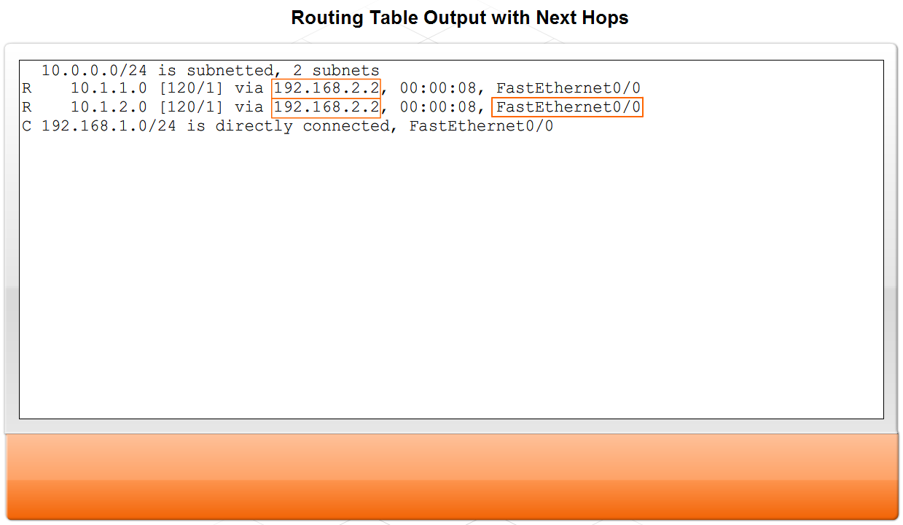
F. McLysaght Network Fundamentals

Slide 22
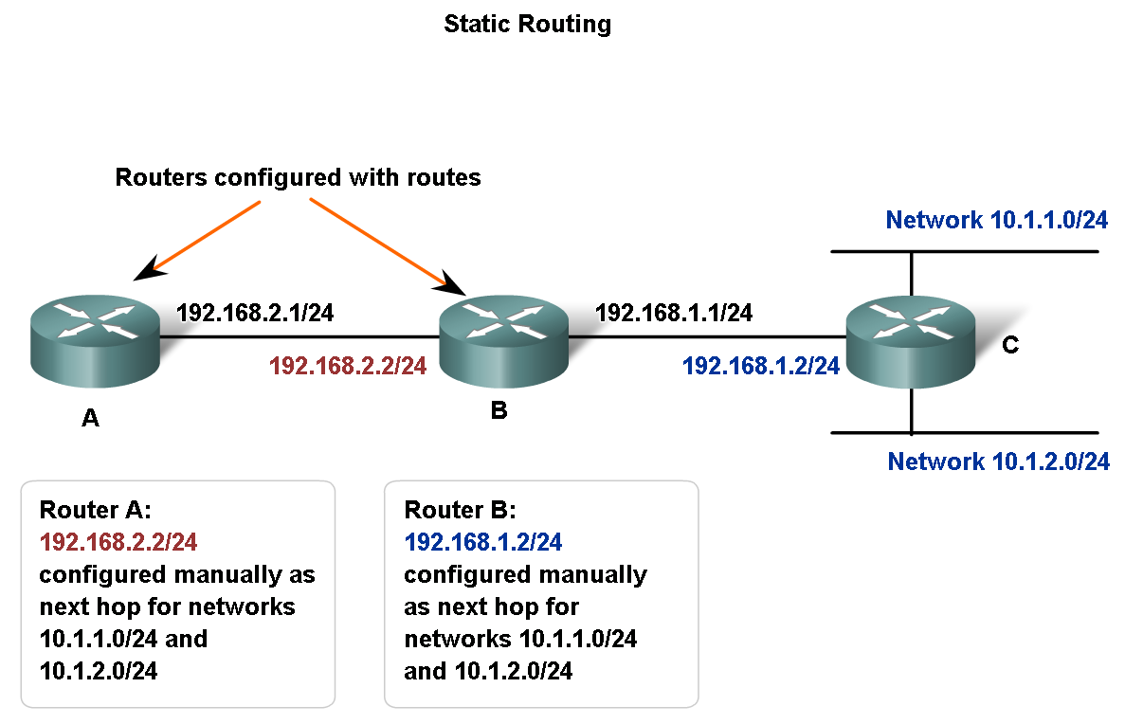
Routing protocols can be either static and/or dynamic.
F. McLysaght Network Fundamentals

Slide 23
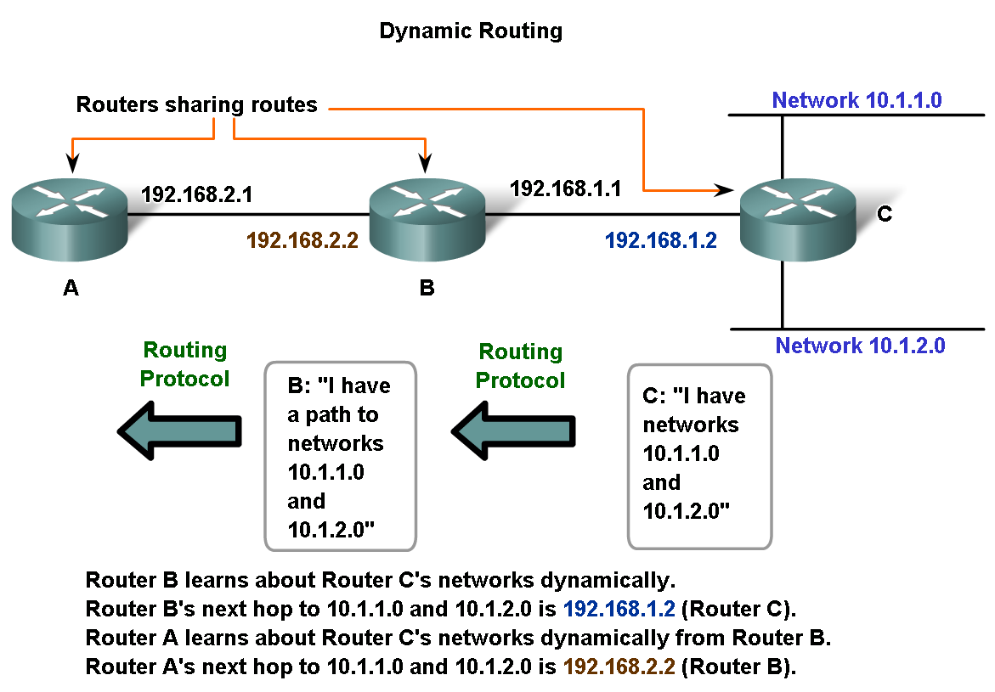
F. McLysaght Network Fundamentals

